Slide 1
CSE440: NATURAL LANGUAGE PROCESSING II
Farig Sadeque
Assistant Professor
Department of Computer Science and Engineering
BRAC University

Slide 2
Lecture 5: Sequence Learning

Slide 3
Outline
Sequence tagging (SLP 8)
Markov models (SLP Appendix A)
Recurrent neural networks (SLP 9)

Slide 4
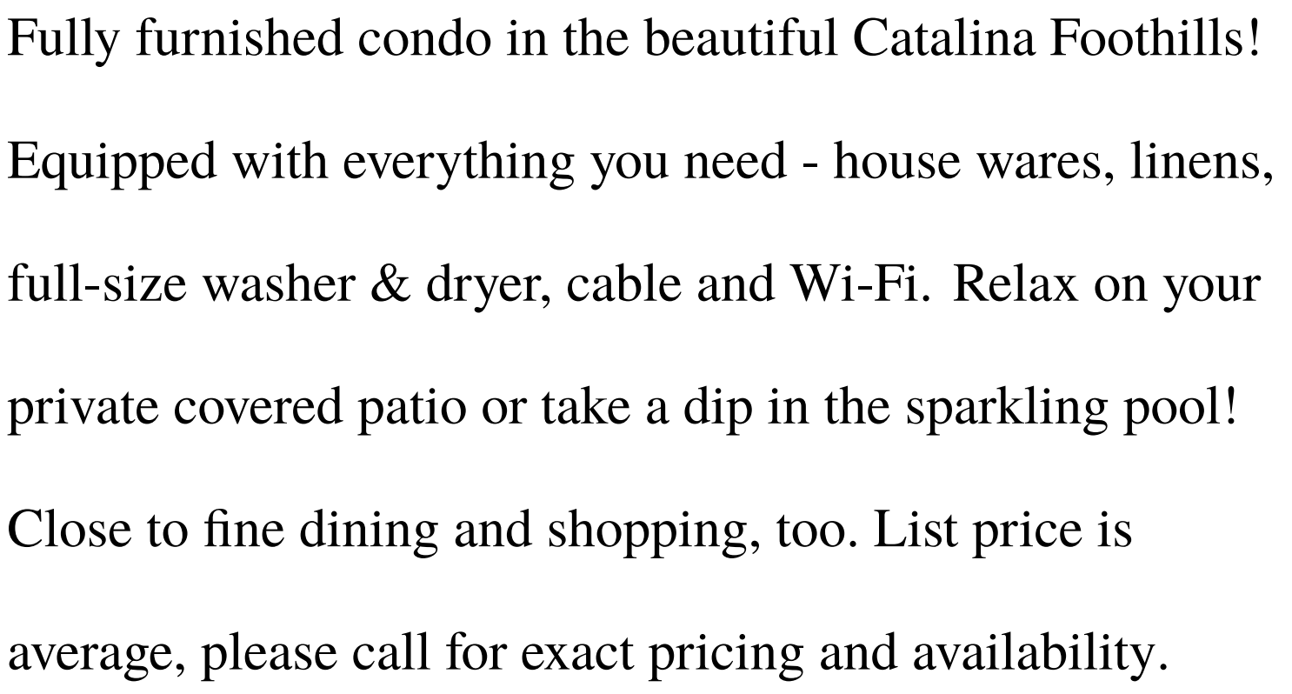
Sequences are common in languages

Slide 5
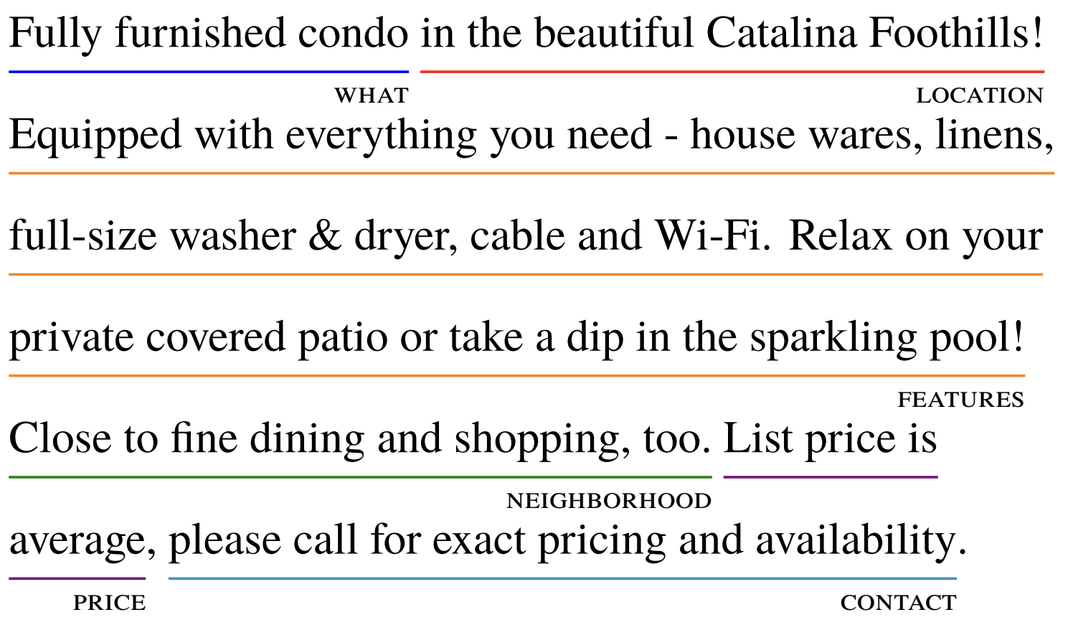
Sequences are common in languages

Slide 6

Sequences are common in languages

Slide 7
Sequences are common in languages
Speech recognition
Group acoustic signal into phonemes
Group phonemes into words
Natural language processing
Part of speech tagging
our running example
Named entity recognition
Information extraction
Question answering

Slide 8
Parts-of-speech tagging
Why not just make a big table?
badger is a NOUN, trip is a VERB, etc.
Because part-of-speech changes with the surrounding sequence:
I saw a badger in the zoo.
Don’t badger me about it!
I saw him trip on his shoelaces.
She said her trip to Greece was amazing.
How big is this ambiguity issue?

Slide 9
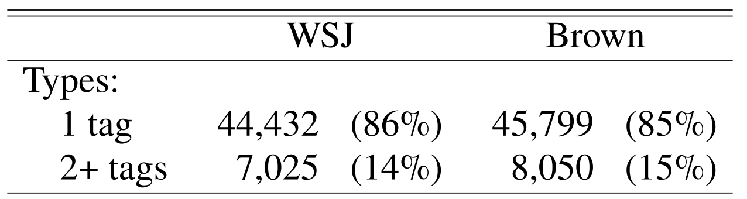
Part-of-speech ambiguity
Most words in the English vocabulary are unambiguous.

Slide 10
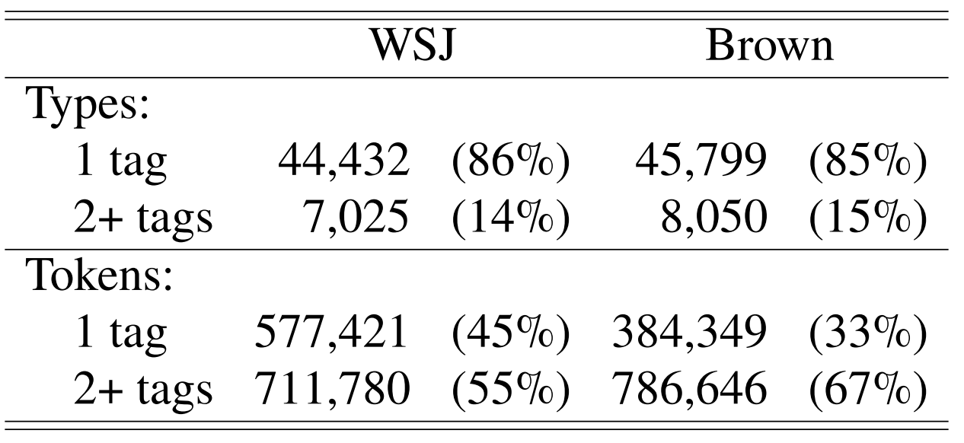
Part-of-speech ambiguity
But, most words in running text are ambiguous! That is, ambiguous words are more prevalent.

Slide 11
A big table is still a good start
Only 30-40% of words in running text are unambiguous.
What if, we have a table for all words, and for ambiguous words, store the most commonly used tag for that word in there?
This is called Most frequent tag baseline
assign each token the tag that it appeared with most frequently in the training data.
92.34% accurate on WSJ corpus.

Slide 12
A big table is still a good start
What’s the tag for cut?
10 cut NN
25 cut VB
13 cut VBD
7 cut VBN

Slide 13
Learning sequence taggers
To improve over the most frequent tag baseline, we should take advantage of the sequence.
Some options we will cover:
Hidden Markov models
Parameters estimated by counting (like naïve Bayes)
Maximum entropy Markov models
Parameters estimated by logistic regression
Recurrent neural networks

Slide 14
Hidden Markov Models
Maximum entropy Markov models (MEMM)
(Visible) Markov models for PoS tagging
Training by counting
Smoothing probabilities
Handling unknown words
Viterbi algorithm

Slide 15
Why POS Tagging Must Model Sequences
Our running example:
Secretariat is expected to race tomorrow.
Secretariat is ________
Race is ________
To understand context, we will predict all tags together.

Slide 16
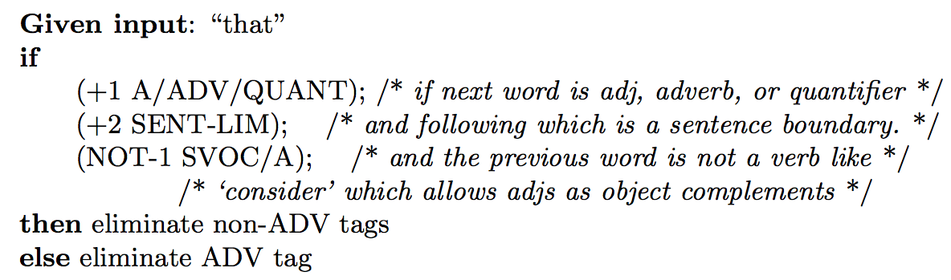
Approach 0: Rule-based baseline
Assign each word a list of potential POS labels using the dictionary
Winnow down the list to a single POS label for each word using lists of hand-written disambiguation rules
You can learn these rules: see Transformation-based Learning: https://dl.acm.org/citation.cfm?id=218367

Slide 17
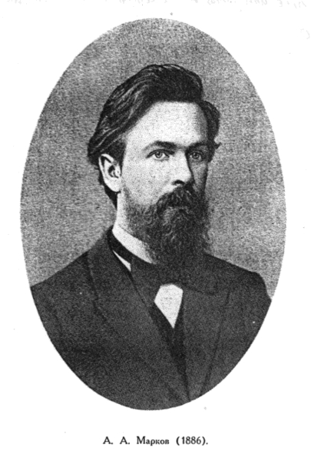
Approach 1: Maximum entropy Markov models
Maximum entropy = logistic regression
Markov models
Discovered by Andrey Markov
Limited horizon
How would you implement sequence models in the logistic regression algorithm that we know?
Let’s assume we scan the text left to right.

Slide 18
Approach 1 continued
Add the previously seen tags as features!
Use gold tags in training
Use predicted tags in testing
Other common features
Words, lemmas in a window [-k, +k]
Casing info, prefixes, suffixes of these words
Bigrams containing the current word
See also: https://github.com/clulab/processors/blob/master/main/src/main/scala/org/clulab/processors/clu/sequences/PartOfSpeechTagger.scala

Slide 19
Approach 1: bidirectional MEMMs
You can stack MEMMs that traverse the text in opposite directions:
Left-to-right direction (same as before)
Right-to-left: uses the prediction(s) of the above system as features!
What is the problem with the predictions of the left-to-right model here?
Many state-of-the-art taggers use this approach: CoreNLP, processors, SVMTool

Slide 20
Approach 2: Hidden (visible) Markov Models
Let’s put the probability theory we covered in the previous lecture to use!
The resulting approach is called (visible) Markov model
“Visible” to distinguish it from the hidden Markov models, where the tags are unknown
Imagine implementing a POS tagger for an unstudied language without POS annotations

Slide 21
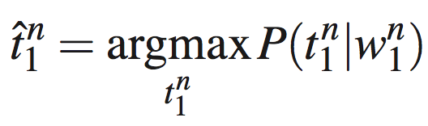
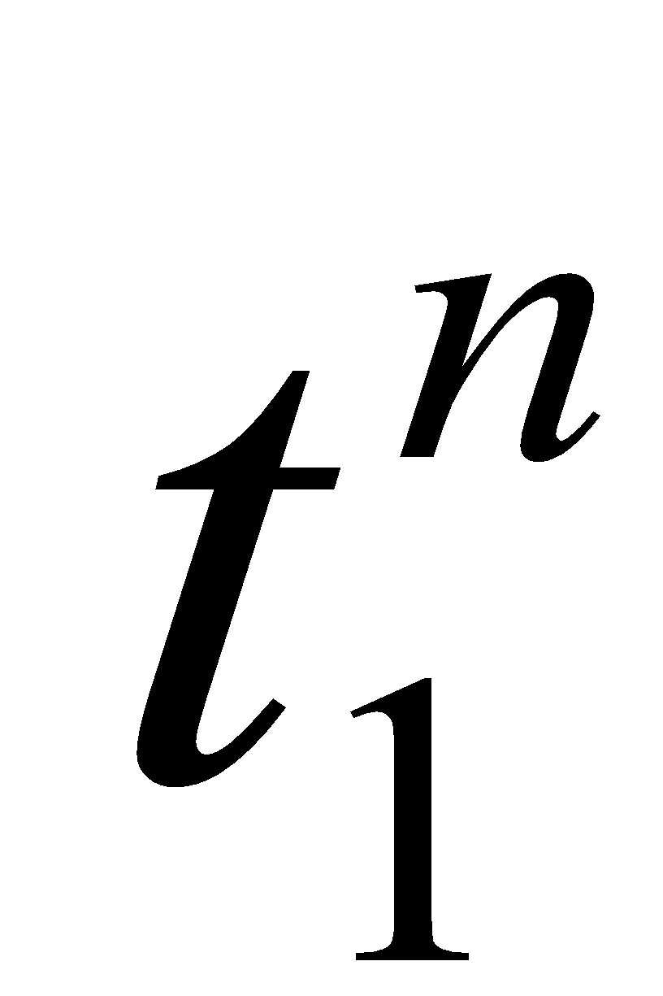
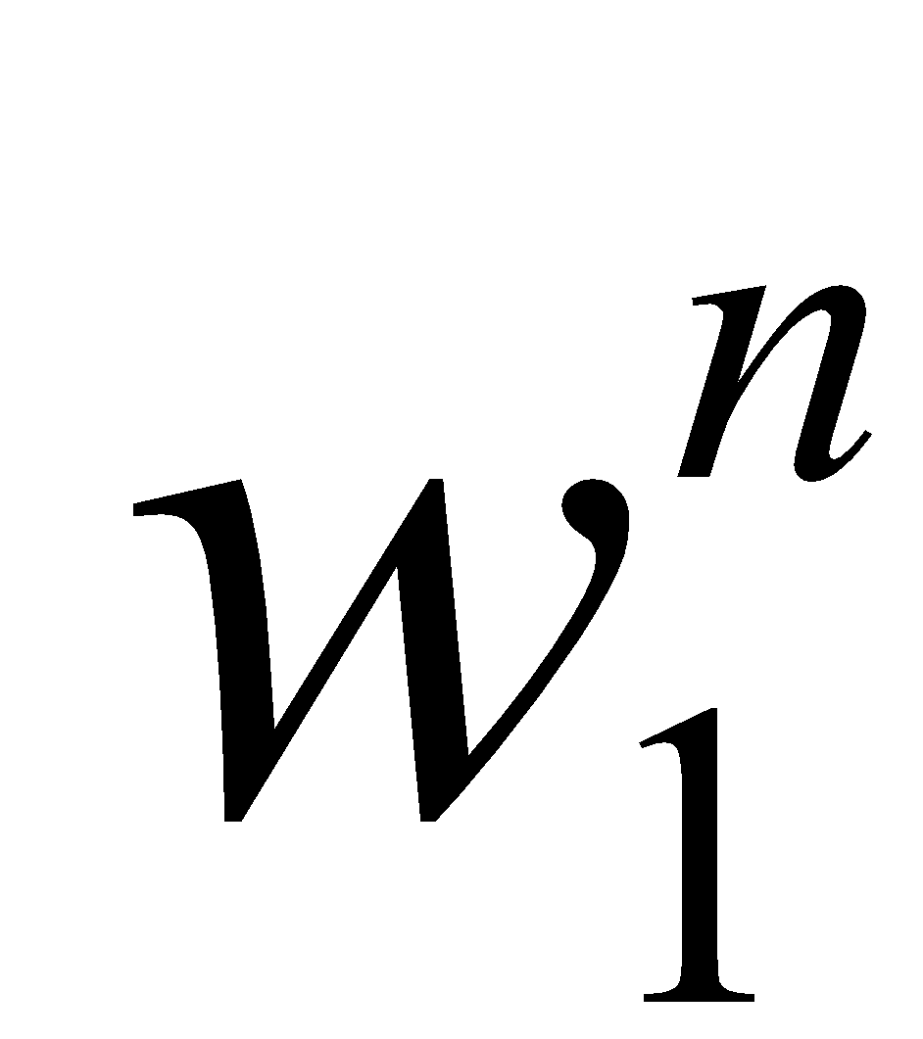
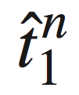
Approach 2: Hidden (visible) Markov Models
Sentence 1 contains n words
- an assignment of POS tags to this sentence
- the words in this sentence
- the estimate of optimal tag assignment

Slide 22
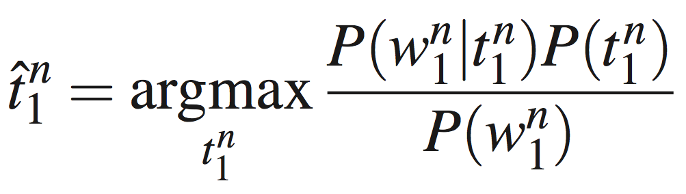
Let’s formalize this
We have four probabilities: likelihood, prior, posterior and marginal likelihood.
Prior: Probability distribution representing knowledge or uncertainty of a data object prior or before observing it
Likelihood: The probability of falling under a specific category or class.
Posterior: Conditional probability distribution representing what parameters are likely after observing the data object
Marginal likelihood: likelihood function that has been integrated over the parameter space. Does not affect inference

Slide 23
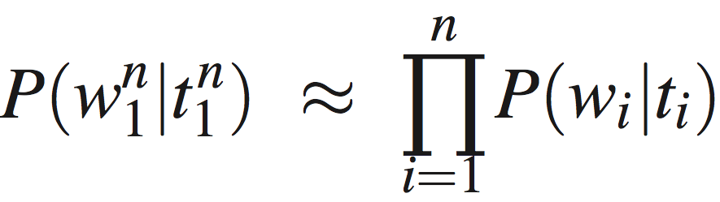
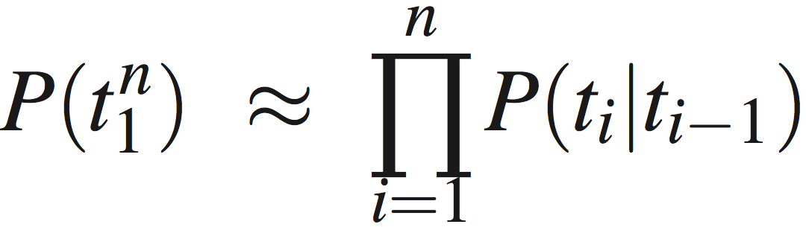
Three Approximations
Words are independent of the words around them
Words depend only on their POS tags, not on the neighboring POS tags
A tag is dependent only on the previous tag

Slide 24
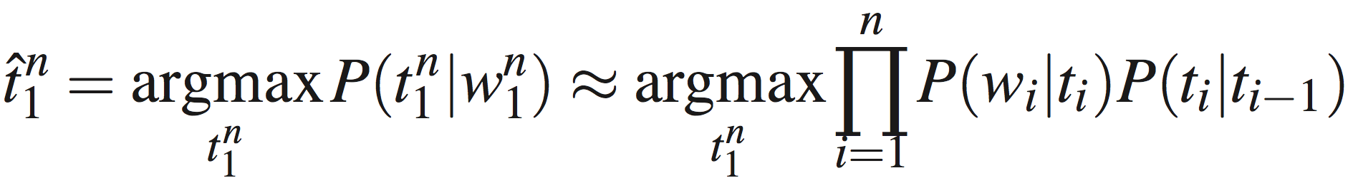
Replace in the original equation
Word likelihoods
Tag transition probabilities

Slide 25
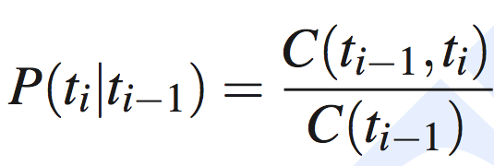
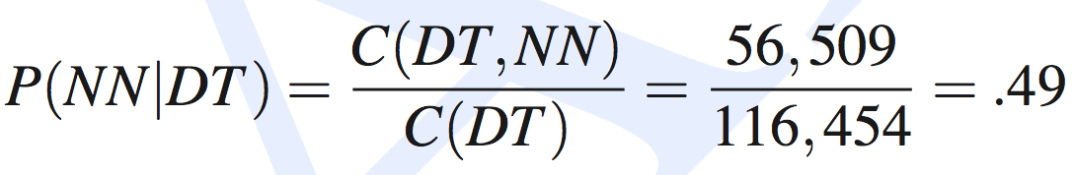
Computing Tag Transition Probabilities
In the Brown corpus (1M words)
DT occurs 116,454 times
DT is followed by NN 56,509 times

Slide 26
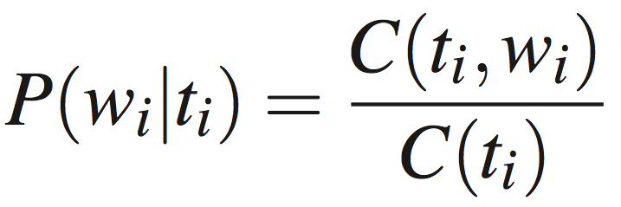
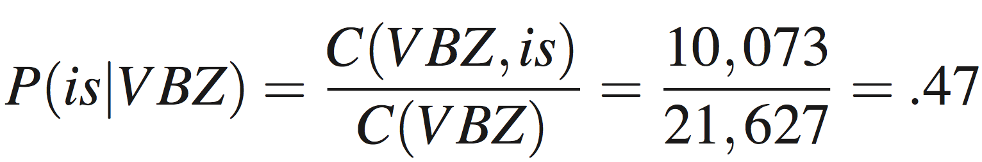
Computing Word Likelihoods
In the Brown corpus (1M words)
VBZ occurs 21,627 times
VBZ is the tag for “is” 10,073 times

Slide 27
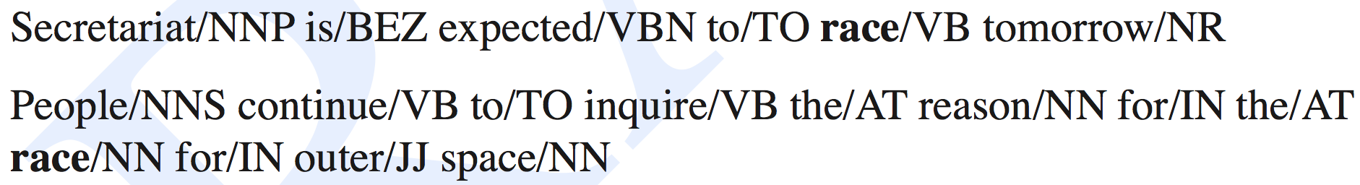
Example
Let’s see why VB is preferred in the first case

Slide 28
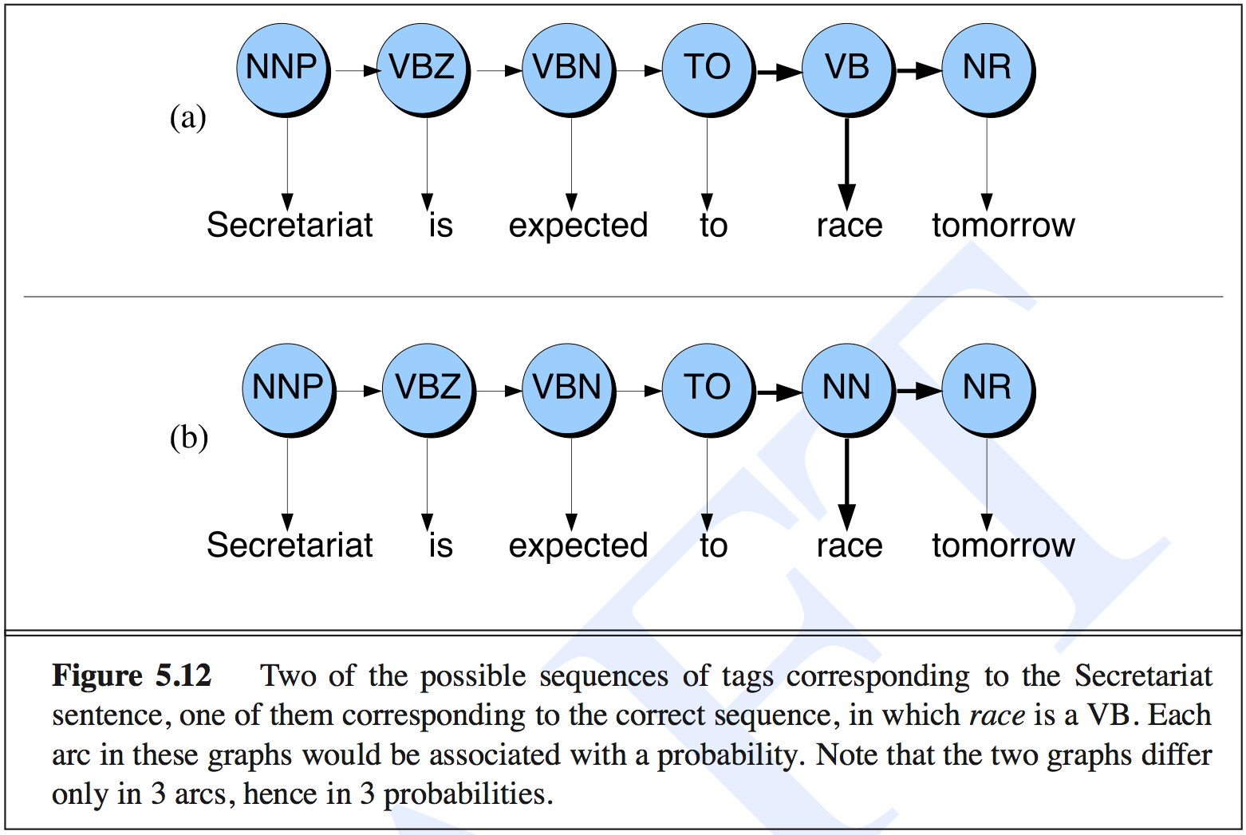
Example

Slide 29
Example
The first tag transition
P(NN|TO) = 0.00047
P(VB|TO) = .83
The word likelihood for “race”
P(race|NN) = 0.00057
P(race|VB) = 0.00012
The second tag transition
P(NR|VB) = 0.0027
P(NR|NN) = 0.0012

Slide 30
Example
P(VB|TO)P(NR|VB)P(race|VB) = 0.00000027
P(NN|TO)P(NR|NN)P(race|NN) = 0.00000000032
VB is more likely than NN, even though “race” appears more commonly as a noun!

Slide 31
Training/Testing an HMM
Just like with any machine learning algorithm, there are two important issues one needs to do to build an HMM:
Training:
Estimating p(t_{i}|t_{i-1}) and p(w_{i}|t_{i})
Testing (predicting):
Estimating the best sequence of tags for a sentence (or sequence or words)

Slide 32
Training: Two Types of Probabilities
A: transition probabilities
Used to compute the prior probabilities (probability of a tag)
Often called tag transition probabilities
B: observation likelihoods
Used to compute the likelihood probabilities (probability of a word given tag)
Often called word likelihoods

Slide 33
Testing: Viterbi Algorithm
Viterbi algorithm
Computes the argmax efficiently
Example of dynamic programming

Slide 34

What is a viterbi?

Slide 35
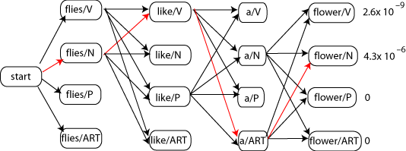
Illustration of Search Space

Slide 36
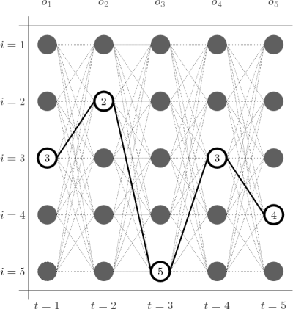
Illustration of Search Space
This is called a trellis
One row for each state (tag)
One column for each observation (word)

Slide 37
Viterbi Algorithm
Input
State (or tag) transition probabilities (A)
Observation (or word) likelihoods (B)
An observation sequence O
Output
Most probable state sequence Q together with its probability
Both A and B are matrices with probabilities

Slide 38
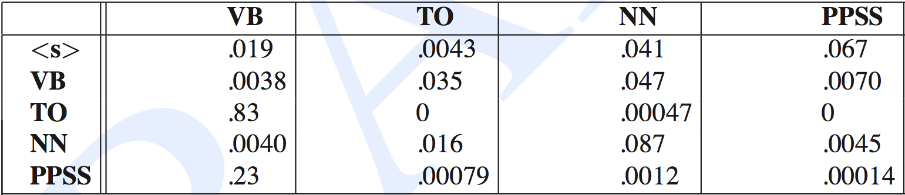
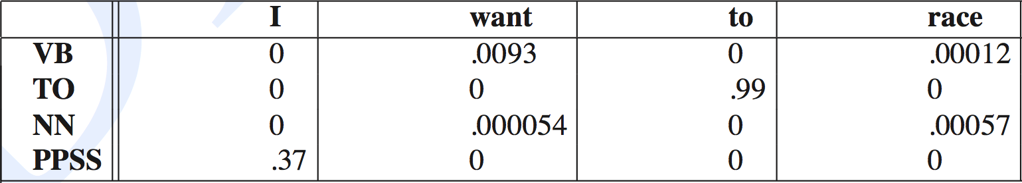
Example of A and B matrices
A: The rows are labeled with the conditioning event, e.g., P(PPSS|VB) = .0070
B: same as A, rows: conditioning events, e.g. P(want|NN) = .000054
‹#›

Slide 39
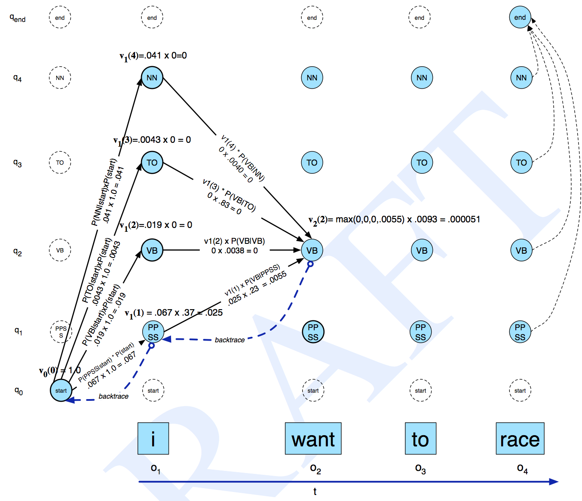
Example Trace

Slide 40
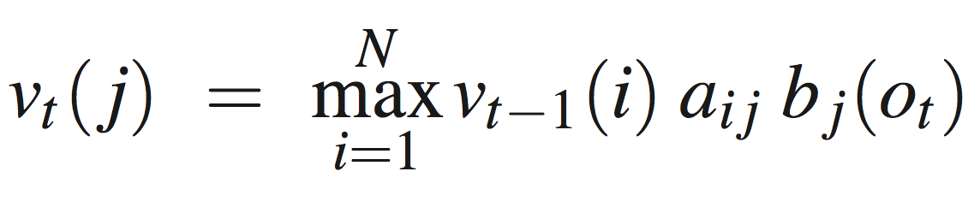
Summary of Viterbi Algorithm
v_{t-1}(i) – the previous Viterbi path probability from the previous time step t – 1 (i.e., the previous word)
a_{ij} – the transition probability from previous state q_{i} (i.e., the previous word having POS tag i) to current state q_{j} (i.e., the current word having POS tag j)
b_{j}(o_{t}) – the state observation likelihood of the observation symbol o_{t} (i.e., word at position t) given the current state j (i.e., the j POS tag)

Slide 41
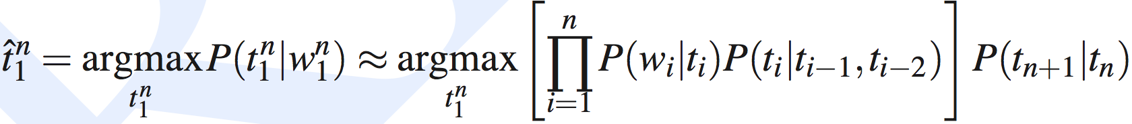
Extending the HMM Algorithm to Trigrams
This is pretty limiting for POS tagging
Let’s extend it to trigrams of tags!
This is better
t_{n+1} – end of sentence tag
We also need virtual tags, t₀ and t₋₁, to be set to the beginning of sentence value.

Slide 42
TnT
This is what the TnT (Trigrams’n’Tags) tagger does
Probably the fastest POS tagger in the world
Not the best, but pretty close (96% acc)
http://www.coli.uni-saarland.de/~thorsten/tnt/

Slide 43
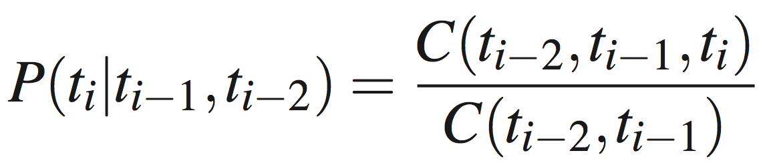
Problems with TnT
Very
sparse!
Backoff model: linear interpolation
P(t_{i}|t_{i-1}t_{i-2} ) = λ₃ Ṕ(t_{i}|t_{i-1}t_{i-2} ) + λ₂ Ṕ(t_{i}|t_{i-1} ) + λ₁ Ṕ(t_{i} )
λ1 + λ2 + λ3 = 1, to guarantee that result is a probability.

Slide 44
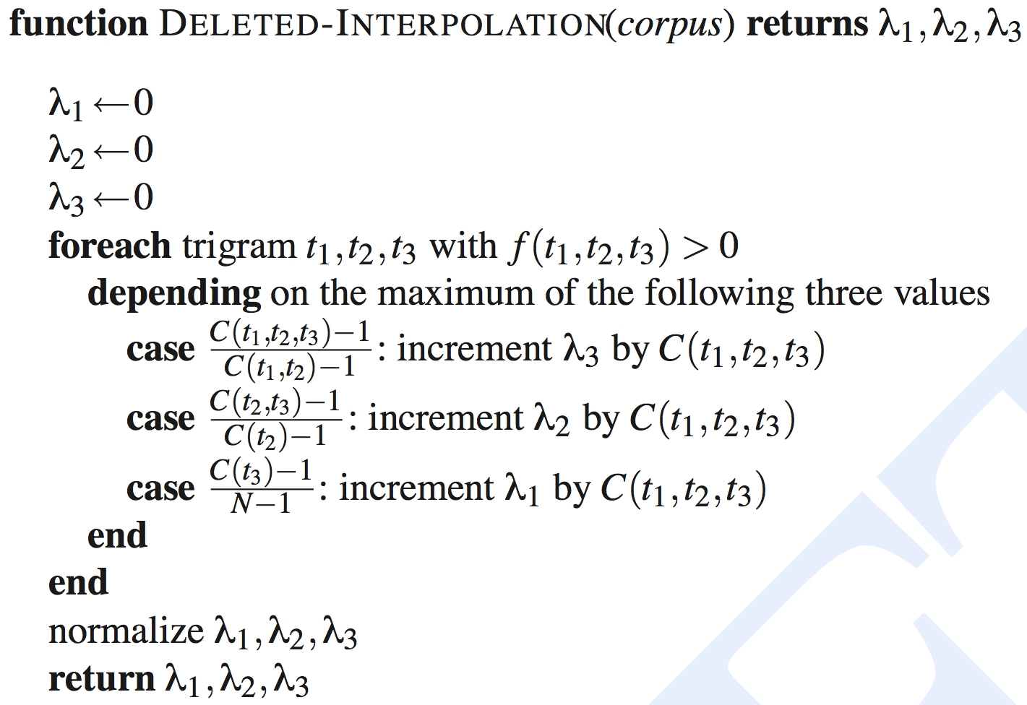
Deleted Interpolation

Slide 45
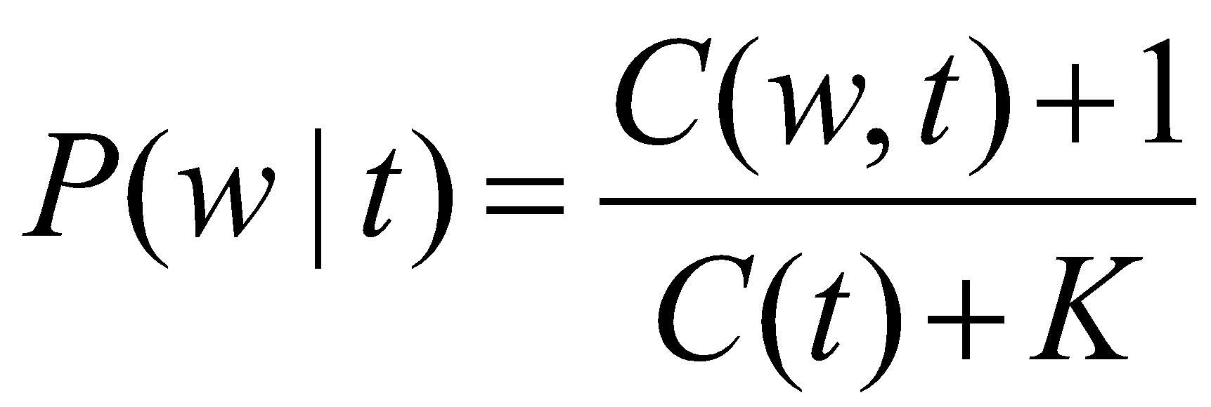
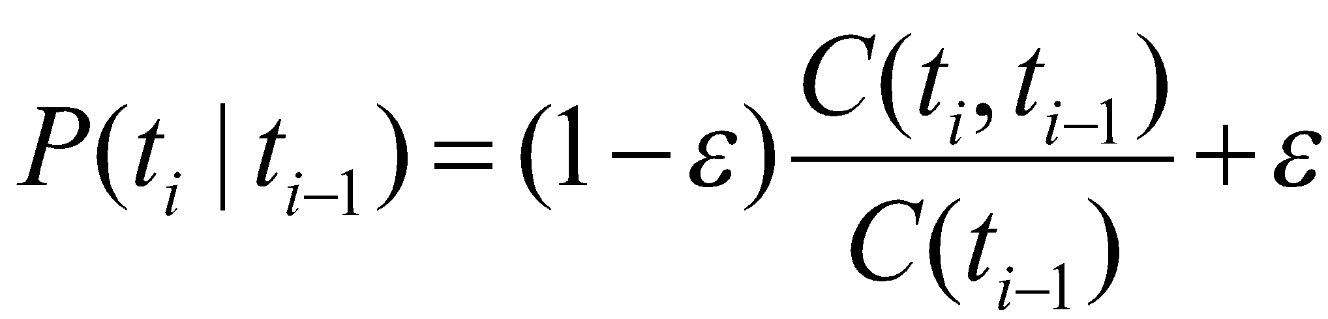
Other Types of Smoothing
Add one:
Where K is the number of words with POS tag t
Variant of add one (Charniak’s):
Not a proper probability distribution!

Slide 46
Another Problem for All HMMs
Massive multiplication here:

Slide 47
Yet Another Problem: Unknown Words
Solution 0 (not great): assume uniform emission probabilities (this is what “add one” smoothing does)
You can exclude closed-class POS tags such as…
This does not use any lexical information such as suffixes
Solution 1: capture lexical information:
This reduces error rate for unknown words from 40% to 20%

Slide 48
Main Disadvantage of HMMs
Hard to add features in the model
Capitalization, hyphenated, suffixes, etc.
It’s possible but every such feature must be encoded in the p(word|tag)
Redesign the model for every feature!
MEMMs avoid this limitation, but they take longer to train

Slide 49
Evaluation
POS tagging accuracy = 100 x (number of correct tags) / (number of words in dataset)
Accuracy numbers currently reported for POS tagging are most often between 95% and 97%
But they are much worse for “unknown” words

Slide 50
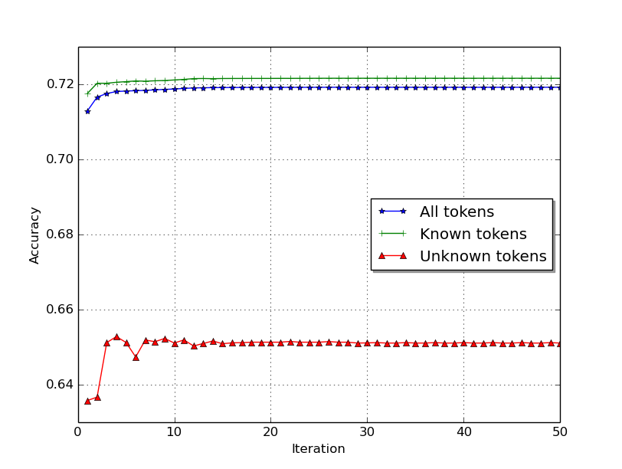
Evaluation example

Slide 51
Evaluation
Accuracy does not work. Why?
We need precision, recall, F1:
P = TP/(TP + FP)
R = TP/(TP + FN)
F1 = 2PR/(P + R)
Micro vs. macro F1 measures

